Slide 1
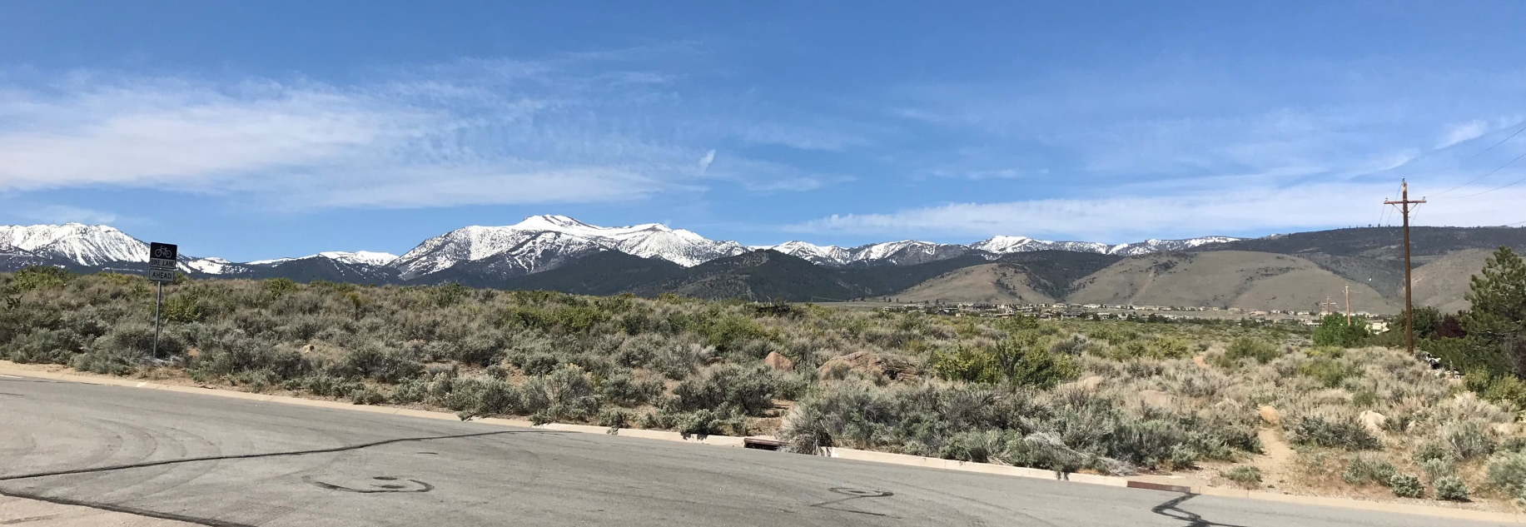
WSUP18-0006 Arrowcreek Middle School Grading
Washoe County Board of Adjustment
June 7, 2018

Slide 2
Overview
The application is requesting to grade an area of approximately ±28.4 acres with ±247,980 cubic yards of cuts and ±251,748 cubic yards of fill and to allow slopes greater than 10 feet in height to facilitate construction of a new Middle School.

Slide 3
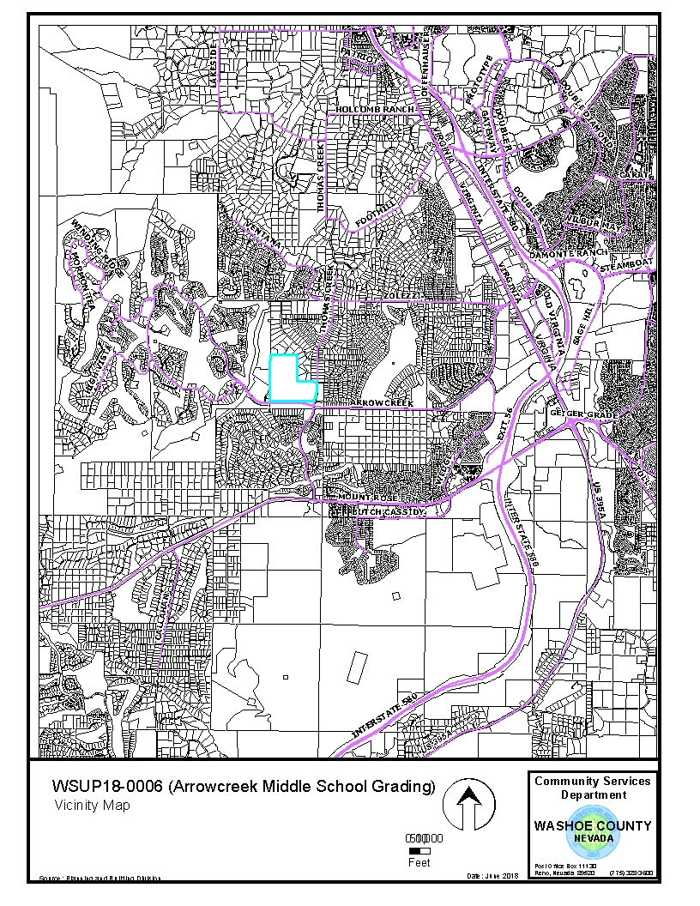
Vicinity Map
Subject Site

Slide 4
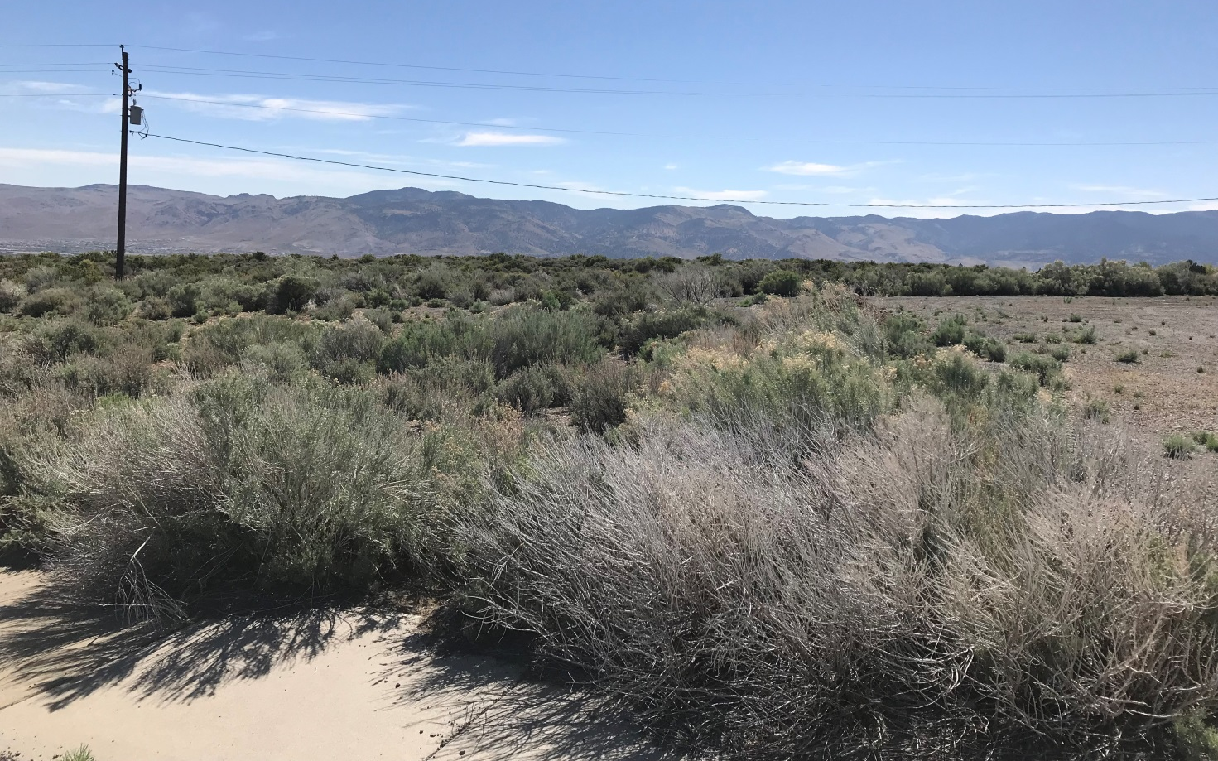
Looking East from Site

Slide 5
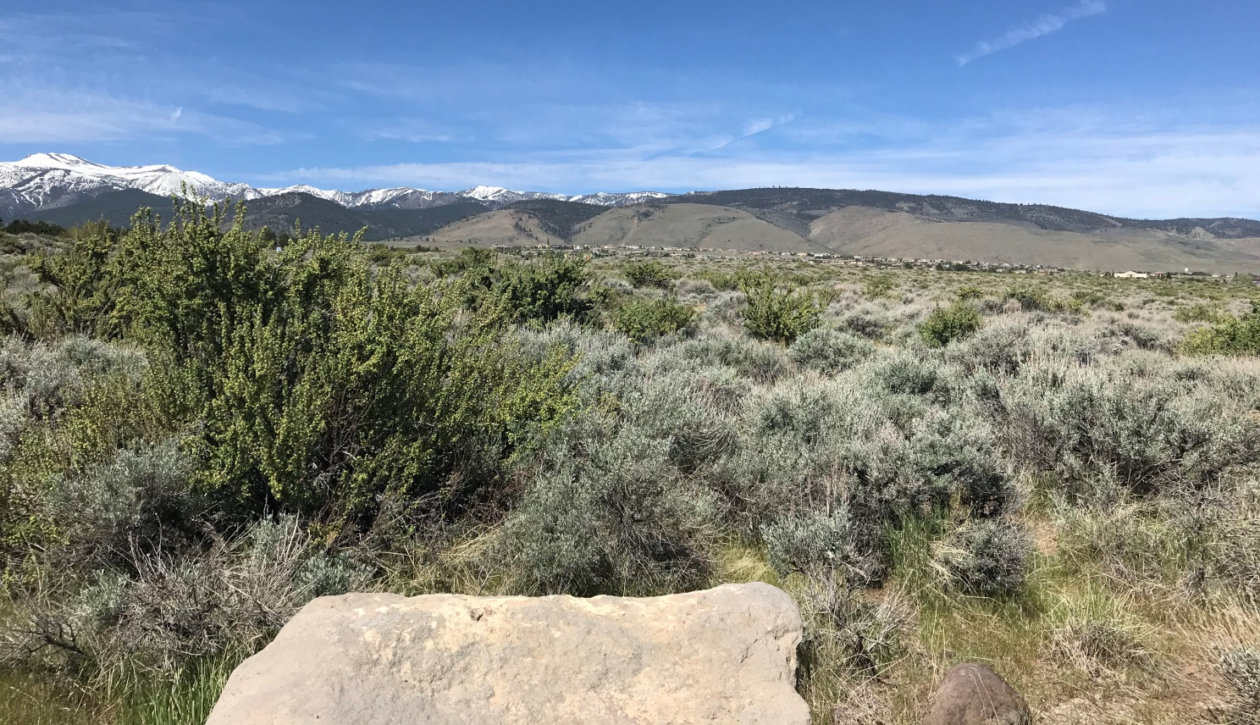
Looking West from Site

Slide 6
Background
Special Use Permit is required by Washoe County Code Section 110.438.35 in all regulatory zones for major grading
The subject property has a regulatory zone of Low Density Suburban (LDS) and the site meets the major grading thresholds (area, volume, & slope) which requires the applicant to seek the approval of Board of Adjustment for a SUP.

Slide 7
Analysis
The site is vacant with native vegetation and no trees
The applicant requested after the application was submitted; to vary the natural slopes by more than 10 feet in elevation
There will be no import or export of material
The grading will be screened from public view, adjacent roadways and neighboring properties with extensive landscaping that includes 566 trees and 2,492 shrubs

Slide 8
Analysis
The School District worked with County Staff and the grading design
The Southwest Area Plan requires grading design to be “an undulating naturalistic appearance by creating a varying curvilinear contours and grading to complement the original contours of the area”.
Conditions of Approval have been recommended to address the identified impacts.

Slide 9
Agency Review & Noticing
4 of the 22 reviewing agencies provided comments and 4 with conditions
The abutting property owners were noticed
Legal notice was posted in Reno Gazette Journal

Slide 10
STMWV CAB & Public Comment
The project was presented to the South Truckee Meadows/Washoe Valley CAB on May 3rd
There were numerous questions and concerns including traffic, dust control, views from existing homes and water runoff
The CAB recommended that the SUP move the application forward to the Board of Adjustment
One email was received which was included in the staff report

Slide 11
Additional Conditions
1. If any blasting is required during the project grading, a blasting mitigation plan will be submitted with the grading plan(s). The blasting mitigation plan will be completed by a qualified contractor.
2. If construction hours are varied for the pouring of concrete slabs, a plan will be submitted to Washoe County for approval by the Planning and Building Director.
3. Construction noise will not exceed 65 dB at the property line and ‘hush’ alarms will be installed to construction vehicles to mitigate noise.

Slide 12
Special Us Permit Findings
Staff is able to make all the required findings, as detailed in the staff report on Page 11

Slide 13
Possible Motion
I move that, after giving reasoned consideration to the information contained in the staff report and information received during the public hearing, the Washoe County Board of Adjustment approve Special Use Permit Case Number WSUP18-0006 with conditions included in Exhibit A and the additional conditions as presented, having made all findings in accordance with Washoe County Code Section 110.810.30

